Slide 1
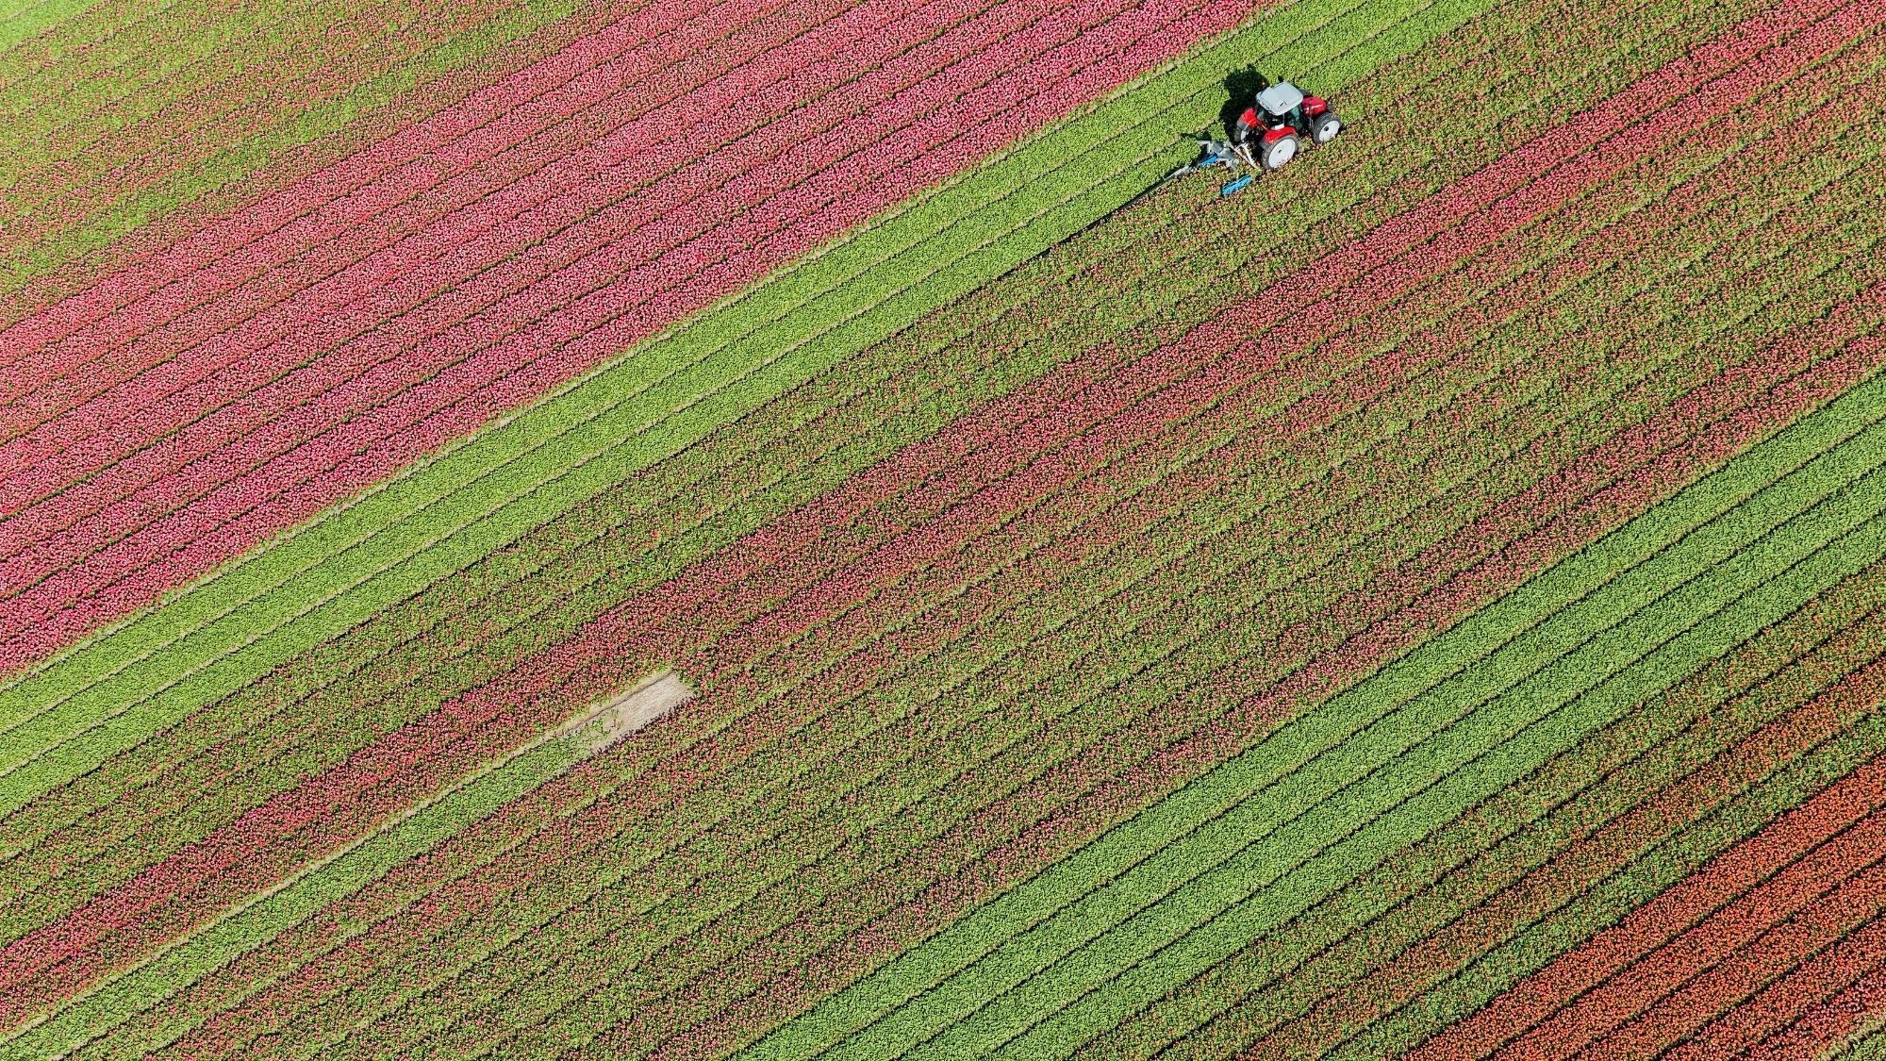

Swarm Robotics ABM Simulation in Agriculture
Initial Demo
Team: Bethlehem B. Bethun B. Tousif S.

Slide 2
Agenda
Progress
Review Project Summary
Progress - Target vs Stretch Goals
Next Steps
Analysis
Actions

Slide 3

Project Summary
Building an Agent-Based simulation algorithm of Swarm Robotics that improves crop yields.
Algorithm focus:
communication efficacy between drones and ground robots
path planning, optimization, and coordination
weed detection and correction
Using Netlogo for agent-based modeling (ABM) of different scenarios.
Note on Changes:
Added Weed Correction for weed removal
Using Netlogo instead of Python MESA
Notes:
We aim to build simulation algorithms of Swarm Robotics by leveraging ground robots and drones in an Agent-Based Model to improve yield optimization.
The algorithms will focus on:
efficiency and effectiveness in communication between the drones and ground robots
path planning, optimization, and coordination
weed detection and correction
The project will explore scenarios with ground-only swarm robots and a combination of ground and aerial vehicles, using the Netlogo for agent-based modeling (ABM).
Note on Changes:
Initially we had planned Weed Detection/ Plant disease identification, however, in the simulation we have added Weed Correction mechanism which removes weed in the simulation.
We also used Netlogo instead of Python MESA as we had difficulty in navigating through the coding and visualization with Python MESA

Slide 4
Target vs Stretch Goals
Target Goal
Coordinating ground robots and drones for weed detection
Path planning for ground swarm robots with Particle Swarm Optimization (PSO) algorithm
Enable aerial drones to survey for the weeds and update the best positions for the ground robots
Stretch Goal
Rescue operations for stuck robots
Integrating aerial vehicles in simulation for more complex tasks
Train agents to detect weed and diseased plants in soya beans using tools such as TensorFlow
Integrate with NetLogo for testing and analysis
Simulation of Weed Removal
Determine energy consumption to determine efficiency
On Target
Limited time availability to implement
Additional Stretch Goals
Notes:
Target Goal
Explore coordination in the ground robots and drones for successful weed detection on datasets of soybean plants
Successfully simulate communication and basic path planning for ground swarm robots to explore Particle Swarm Optimization (PSO) algorithm
Enable coordination between the ground robots and aerial drones for defined use cases
Stretch Goal
Implementing advanced coordination strategies, like rescue operations for stuck robots, and integrating aerial vehicles into the simulation for complex tasks
Training agents to detect weed and diseased plants in soya beans using tools such as TensorFlow and integrate with NetLogo code for testing and analysis
Simulation of Weed Removal
Determine energy consumption to determine efficiency

Slide 5
Demo

Slide 6
Next Steps

Slide 7
Data Analysis
Variables Used
Time
Energy
Range
Number of G. Robots
Number of Drones
Weed/Plant Probability
Notes:
Using Behaviour Space Tool in Netlogo to run tests for different variables
Performing data analysis and additional visualizations using Python libraries

Slide 8
Planned Actions
By 19th April - Finalize and complete the analysis
By 25th April - Validate PSO logic in the code
By 25th April - Optimize the code (if required)
By May 3rd - Complete report

Slide 9
Thank You

